Slide 1
ToMNET project
莊昀軒

Slide 2
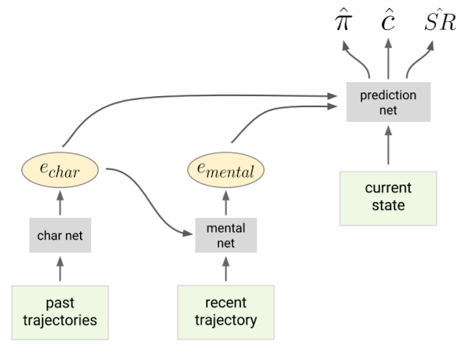

Slide 3

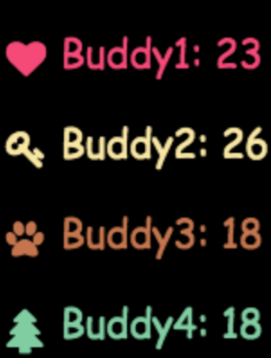
Scores you get for reaching each target
小明
小美
小熊
小樹

Slide 4
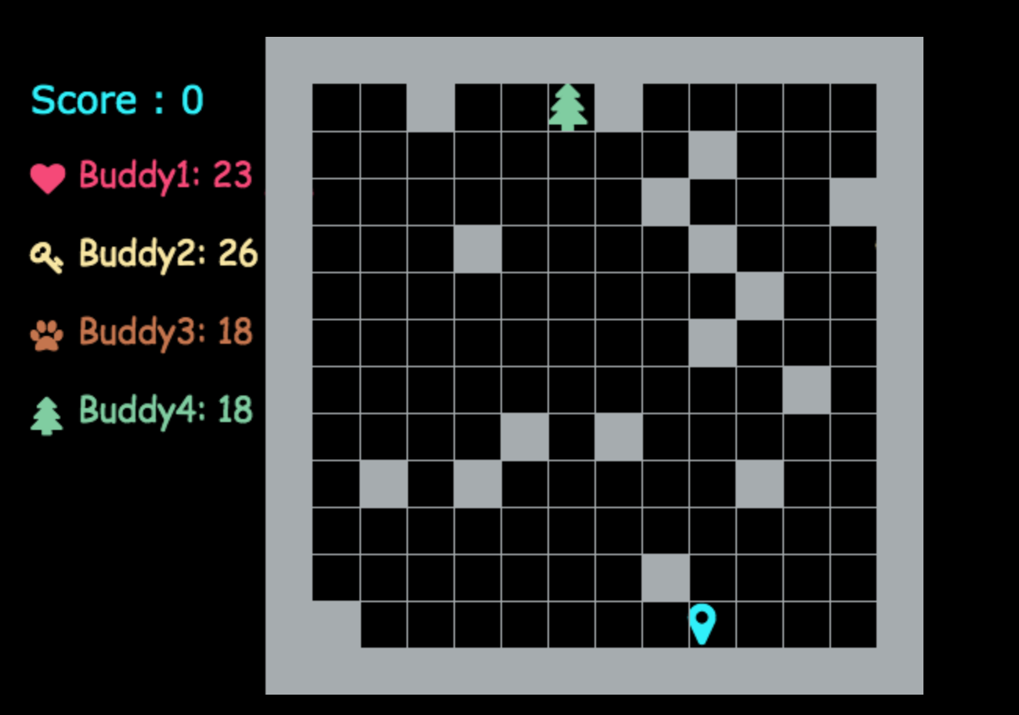
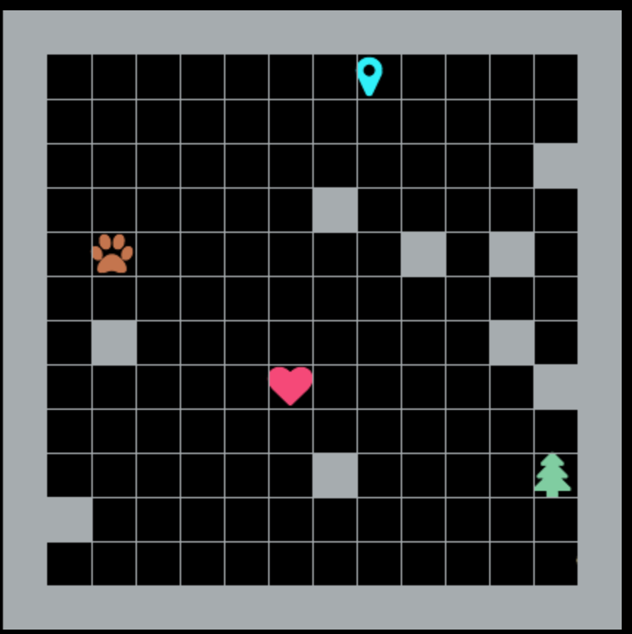






“Each step costs 1 point,
which target do you want to reach?”
Current Score: 0
小明: 23
小美: 26
小熊: 18
小樹: 18

Slide 5
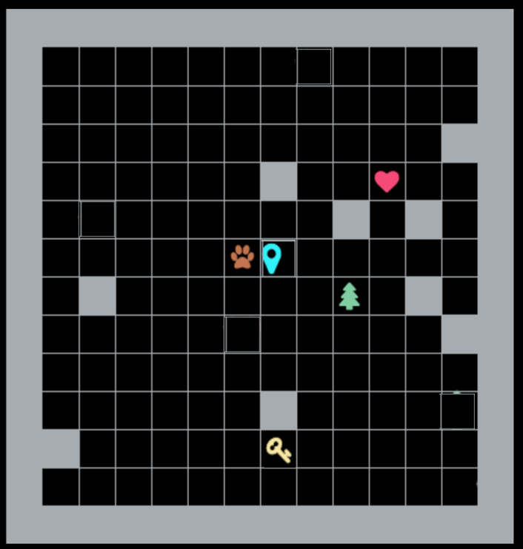
Final Score: 26-7=19
小明: 23
Anne: 23
Ben: 26
Matt: 18
小樹: 18
Amy: 18

Slide 6


Char Net Architecture
$$τ_{ij}={\left\{(x_{t},a_{t})\right\}}_{t=0}^{T}$$
Spatialization-Concatenation
Resnet
LSTM
Average Pooling
Linear
12x12x44 tensor
$$e_{char,i}$$

Slide 7
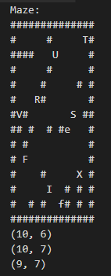

Spatialization-Concatenation
4 potential actions (up, down, left, right)
38 potential goals (A, B, ..., Z, a, b, …, m \S)
1 obstacles (all #)
1 agent initial position (S)
12
One tensor represents one step in the trajectory:
Sparse
Binary
3-dimensional
$$τ_{ij}={\left\{(x_{t},a_{t})\right\}}_{t=0}^{T}$$
12

Slide 8
4 potential actions (up, down, left, right)
4 potential targets (A, B, C, D)
1 obstacles (all #)
1 agent initial position (S)
……
12
12
12 x 12 x 10 tensor
One trajectory = 12 x 12 x 10 x (number of steps) tensor

Slide 9
Char Net Architecture
$$τ_{ij}={\left\{(x_{t},a_{t})\right\}}_{t=0}^{T}$$
Spatialization-Concatenation
Resnet
LSTM
Average Pooling
Linear
12x12x11 tensor
5 layers
32 channels
ReLu nonlinearity
Batch-normalization
Like a convnet with identity forwarding
12x12x32 tensor
$$e_{char,i}$$

Slide 10
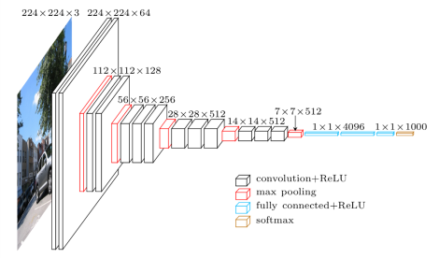
Resnet (Residual Network) Layer
x
“… passing through a 5-layer resnet, with 32 channels, ReLU nonlinearities, and batch-norm...”
Channels in CNNs refers to the number of feature maps extracted from one “image”.
Convolution
Batch Normalization
ReLu
1 layer
(residual block)
<- e.g. this layer has 64 channels
Convolution
Batch Normalization
ReLu
y
[1] Kaiming He, Xiangyu Zhang, Shaoqing Ren and Jian Sun, “Deep Residual Learning for Image Recognition”, Microsoft Research, arXiv:1512.03385v1 [cs.CV] 10 Dec 2015
Notes:
Fixed: See commit: 4ebb7294d4593a0407273467a91b3fc85f8eb990
References:
https://zhuanlan.zhihu.com/p/28413039
Currently - “(c) ReLU before addition”: # Note that conv_bn_relu_layer() includes both ReLU nonlinearities and batch-norm with tf.variable_scope('conv1_in_block'): conv1 = conv_bn_relu_layer(input_layer, [3, 3, input_channel, output_channels], stride) with tf.variable_scope('conv2_in_block'): conv2 = conv_bn_relu_layer(conv1, [3, 3, output_channels, output_channels], stride) output = conv2 + input_layer [This line is wrong]
Fix –
Following the original paper, should be “(a) original”:
a[l+2] = g(z[l+2]+a[l]) = g(w[l+2]*a[l+1] + b[l+2] + a[l])
Currently “(c) ReLU before addition”:
a[l+2] =g(z[l+2])+ a[l]

Slide 11
Char Net Architecture
$$τ_{ij}={\left\{(x_{t},a_{t})\right\}}_{t=0}^{T}$$
Spatialization-Concatenation
Resnet
LSTM
Average Pooling
Linear
12x12x32 tensor
Reduces the sample size
6x6x32 tensor
$$e_{char,i}$$

Slide 12
Average Pooling Layer
12x12x11
x
“…followed by average pooling…”
In image classification CNNs, a pooling layer usually reduces the width and height of an image by half.
In our case the tensor after pooling is 6x6x32
RB_1
12x12x32
RB_2
RB_3
RB_4
RB_5
12x12x32
average pooling
6x6x32
y

Slide 13
Char Net Architecture
$$τ_{ij}={\left\{(x_{t},a_{t})\right\}}_{t=0}^{T}$$
Spatialization-Concatenation
Resnet
LSTM
Average Pooling
Linear
1152-dim (6x6x32) vectors
64-dim vector
$$e_{char,i}$$

Slide 14


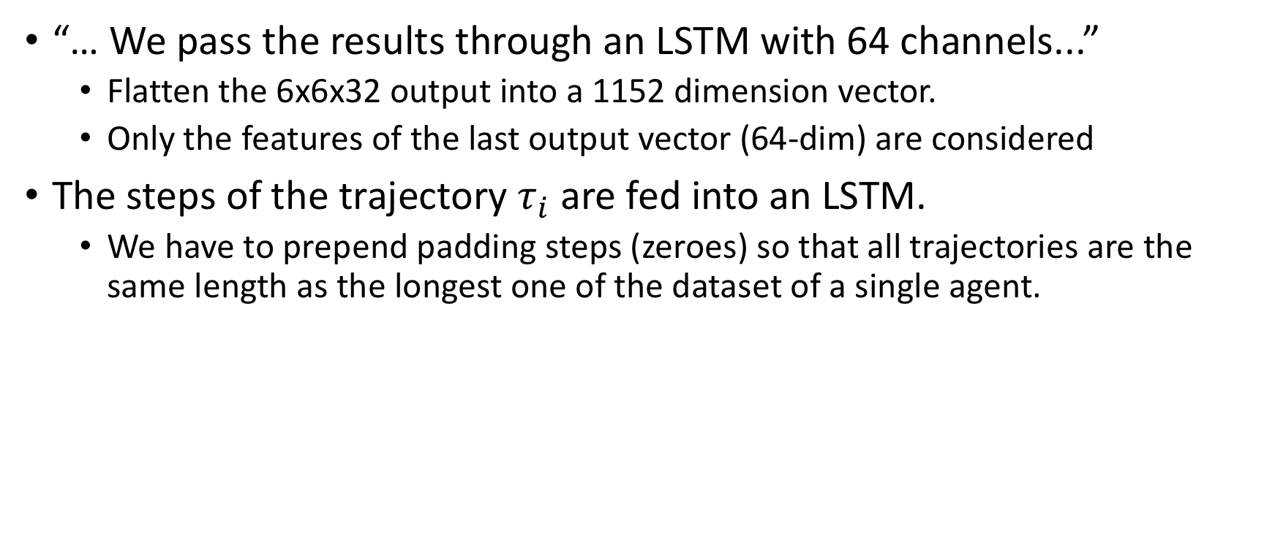



LSTM Layer
“… We pass the results through an LSTM with 64 channels...”
Flatten the 6x6x32 output into a 1152 dimension vector.
Only the features of the last output vector (64-dim) are considered
The steps of the trajectory $τ_{i}$ are fed into an LSTM.
We have to prepend padding steps (zeroes) so that all trajectories are the same length as the longest one of the dataset of a single agent.
64-dim
$$τ_{i}$$
1152-dim
$$τ_{0}$$
$$τ_{1}$$
$$τ_{2}$$
$$τ_{i}$$

Slide 15
Char Net Architecture
$$τ_{ij}={\left\{(x_{t},a_{t})\right\}}_{t=0}^{T}$$
Spatialization-Concatenation
Resnet
LSTM
Average Pooling
Linear
64-dim vector
2 or 8-dim vector
$$e_{char,i}$$

Slide 16

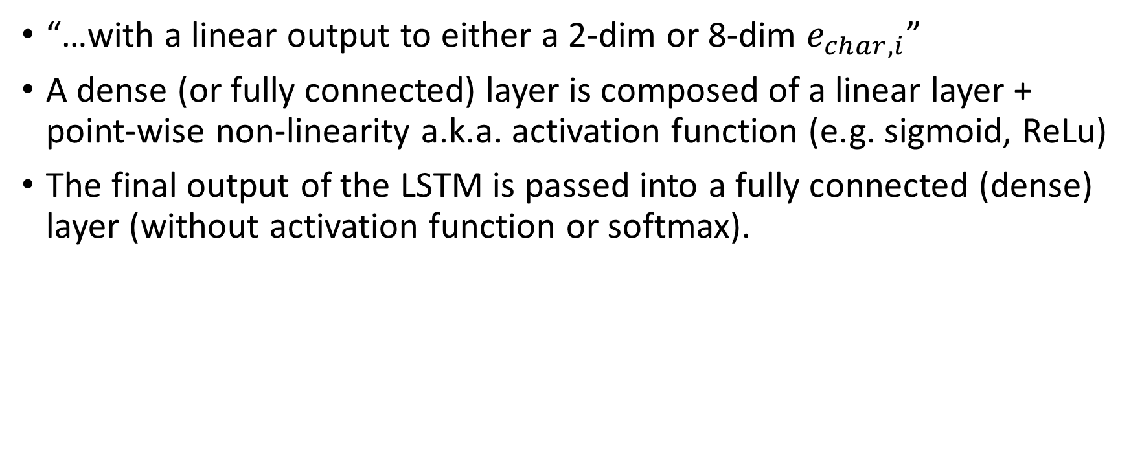
Linear Layer
“…with a linear output to either a 2-dim or 8-dim $e_{char,i}$”
A dense (or fully connected) layer is composed of a linear layer + point-wise non-linearity a.k.a. activation function (e.g. sigmoid, ReLu)
The final output of the LSTM is passed into a fully connected (dense) layer (without activation function or softmax).
LSTM (last output)
64-dim vector
FC Layer
32 nodes
$$e_{char}$$
2 or 8-dim vector

Slide 17
Current Structure
One Past trajectory
resnet
……
LSTM
softmax
Final target

Slide 18
Performance metrics
Data type | Final Target Accuracy | Predicted Preference Ranking | True Preference Ranking
Simulated data (10k trajectories) | 99.9% | D > C > A > B | D > C > A > B
Human data (10k trajectories) | 99.7% | A > B ~ C ~ D | A > B = C = D

Slide 19
Target Structure
One Past trajectory
resnet
“character”
vector
……
LSTM
A new game
resnet
softmax
Final target

Slide 20
One Past trajectory
resnet
……
LSTM
A new game
character
vector
Final target
resnet
softmax

Slide 21
Target Structure

Slide 22


Third Task: Model Prediction Net (Goal Inference)
$e_{char,i}$ + query state
Spatialization-Concatenation
Resnet
Average Pooling
1 layer Convnet
Fully Connected
11x11x(K+5) tensors
5 layers
32 channels
ReLU nonlinearity
Batch normalization
32 channels
ReLU nonlinearity
Bernoulli probability for each object to be reached by the end of the episode.
$$\hat{c}∈ℝ^{N_{target}}$$

Slide 23
Preference prediction
One Past trajectory
resnet
“character”
vector
……
LSTM
A new game
resnet
softmax
Final target

